Slide 1
Rerewhakaaitu data for Polyphenology data share
8 April 2025

Slide 2
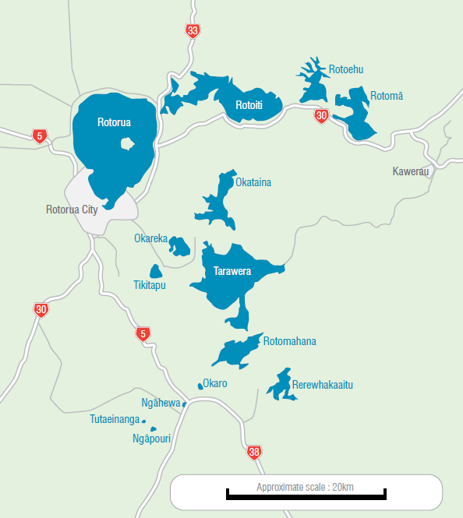
Rotorua
Mean depth = 16m
Volume 0.802 km³
Rerewhakaaitu
Mean depth = 8.4m
Volume 0.037 km³
Okaro (monomictic)
Mean depth 12.34
Volume = 0.003 km³

Slide 3
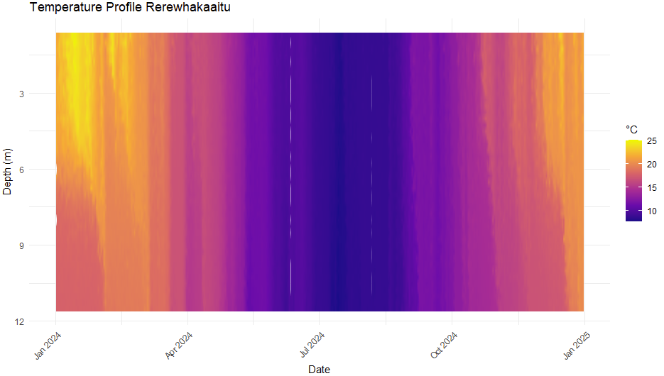

Slide 4
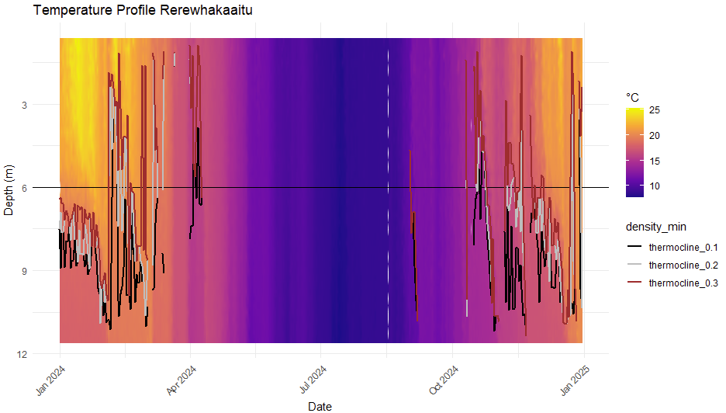
Compare to monomictic lake?

Slide 5
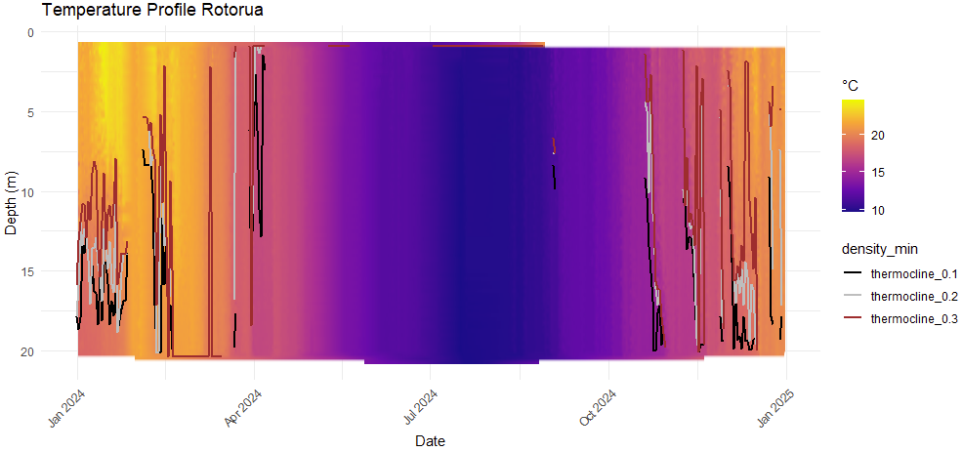
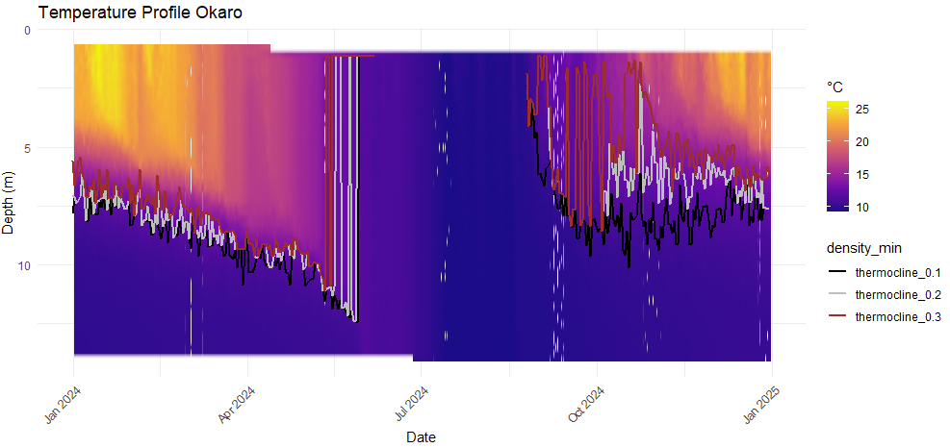

Slide 6
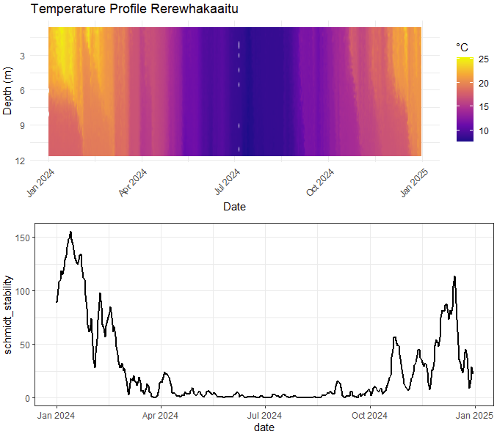
Coefficient of variation = 1.4

Slide 7
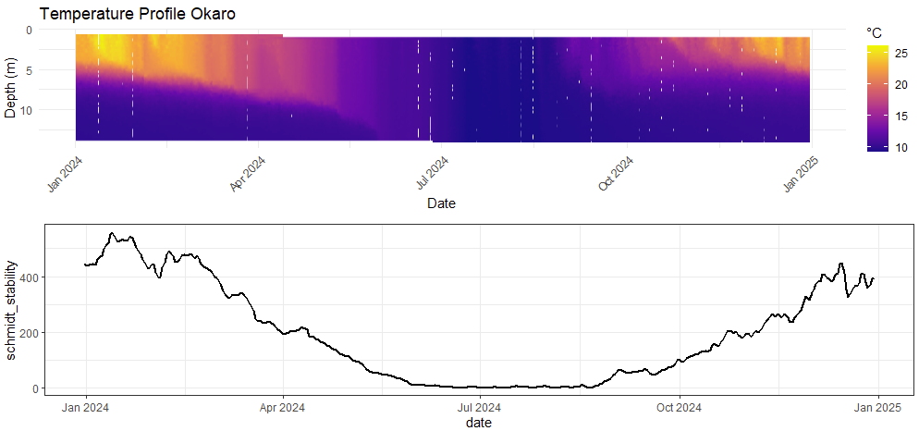
Coefficient of variation = 0.9

Slide 8
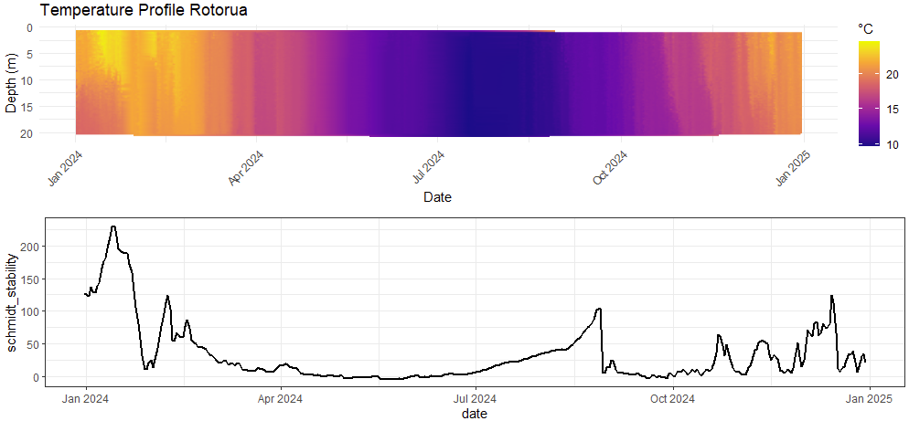

Slide 9
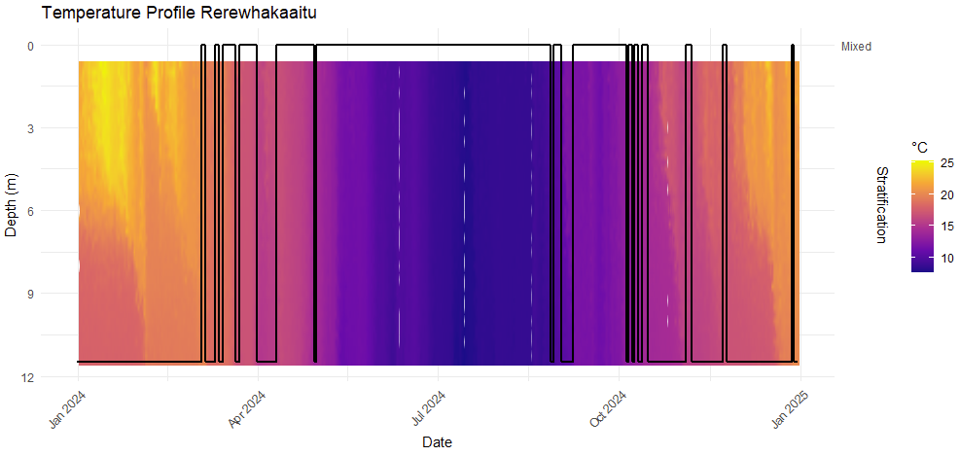
Black line shows whether the lake is mixed (top) or stratified (bottom).
Stratified is defined as if the thermocline depth is greater than 0
Other ways to define this?

Slide 10
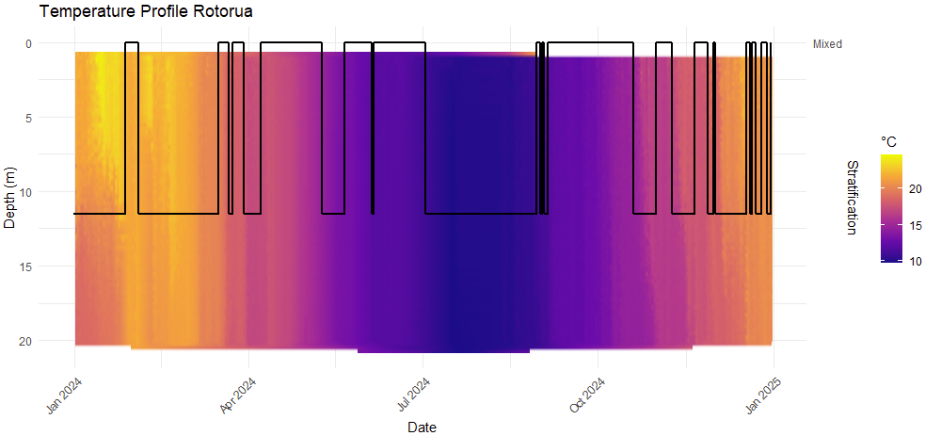
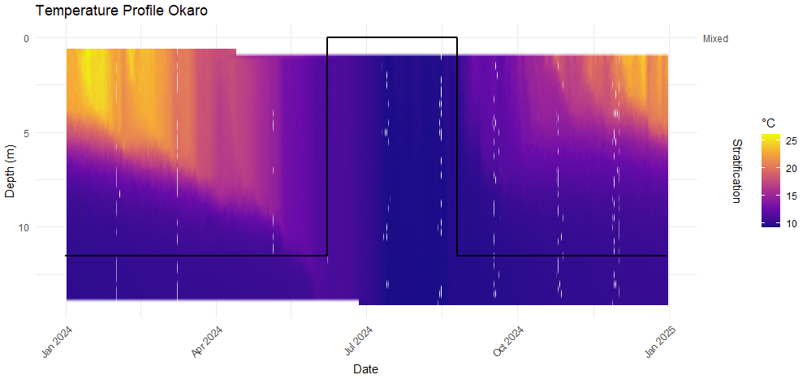

Slide 11
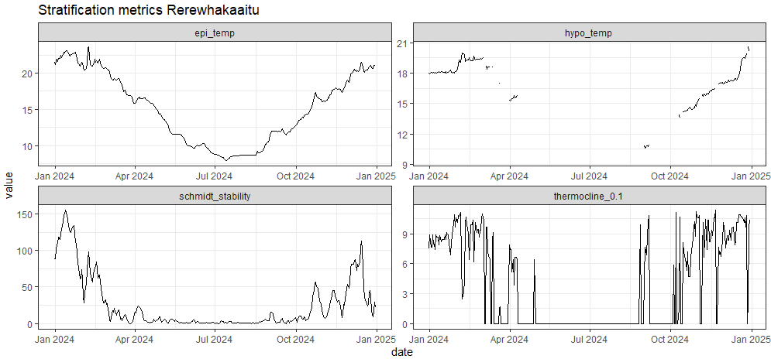

Slide 12
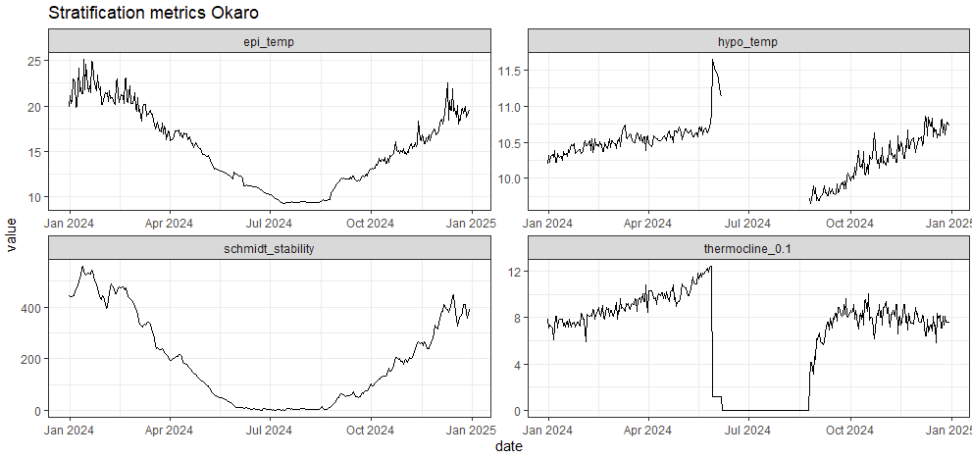

Slide 13
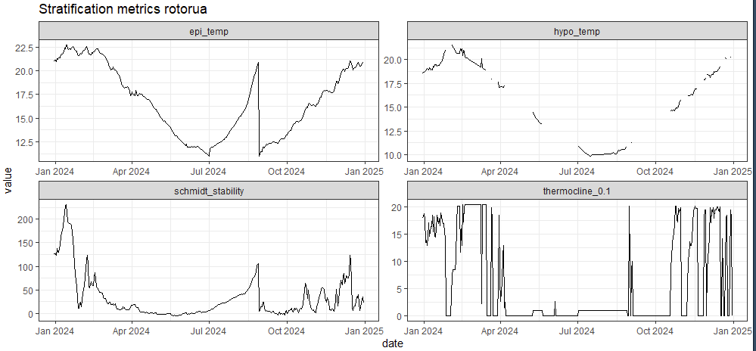

Slide 14
Other things to look at
What are different ways to capture the degree of polymixis/cumulative impact of stratification events?
How do different definitions of stratification influence “stratification responses”? (e.g., # of times mixing)
How does cumulative Schmidt stability compare across mixing regimes?
How would we calculate a normalized Schmidt stability? Normalize by…volume?
How does stratification influence oxygen dynamics…

